Slide 1
Name: Muhammad Adeel Reg No: FA20-BSE-163 Subject: Design Pattern Topic: Queue Based Load Leveling

Slide 2
Queue-Based Load Leveling pattern

Slide 3
Intent:
Use a queue that acts as a buffer between a task and a service that it invokes in order to smooth intermittent heavy loads that may otherwise cause the service to fail or the task to time out.
This pattern can help to minimize the impact of peaks in demand on availability and responsiveness for both the task and the service.

Slide 4
Context and problem
Many solutions in the cloud involve running tasks that invoke services. In this environment, if a service is subjected to intermittent heavy loads, it can cause performance or reliability issues.
A service could be part of the same solution as the tasks that use it, or it could be a third-party service providing access to frequently used resources such as a cache or a storage service. If the same service is used by a number of tasks running concurrently, it can be difficult to predict the volume of requests to the service at any time.
A service might experience peaks in demand that cause it to overload and be unable to respond to requests in a timely manner. Flooding a service with a large number of concurrent requests can also result in the service failing if it's unable to handle the contention these requests cause.

Slide 5
Solution
Refactor the solution and introduce a queue between the task and the service. The task and the service run asynchronously. The task posts a message containing the data required by the service to a queue. The queue acts as a buffer, storing the message until it's retrieved by the service. The service retrieves the messages from the queue and processes them. Requests from a number of tasks, which can be generated at a highly variable rate, can be passed to the service through the same message queue. This figure shows using a queue to level the load on a service.

Slide 6
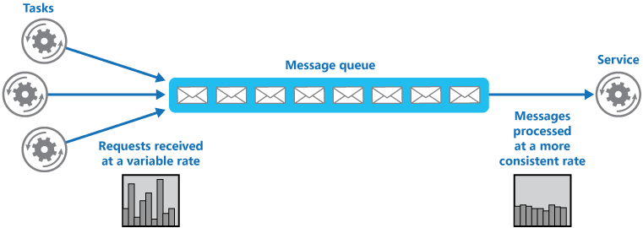

Slide 7
The queue decouples the tasks from the service, and the service can handle the messages at its own pace regardless of the volume of requests from concurrent tasks.
Additionally, there's no delay to a task if the service isn't available at the time it posts a message to the queue.

Slide 8
This pattern provides the following benefits:
It can help to maximize availability because delays arising in services won't have an immediate and direct impact on the application, which can continue to post messages to the queue even when the service isn't available or isn't currently processing messages.
It can help to maximize scalability because both the number of queues and the number of services can be varied to meet demand.
It can help to control costs because the number of service instances deployed only have to be adequate to meet average load rather than the peak load.

Slide 9
When to use this pattern
This pattern is useful to any application that uses services that are subject to overloading.
This pattern isn't useful if the application expects a response from the service with minimal latency.

Slide 10
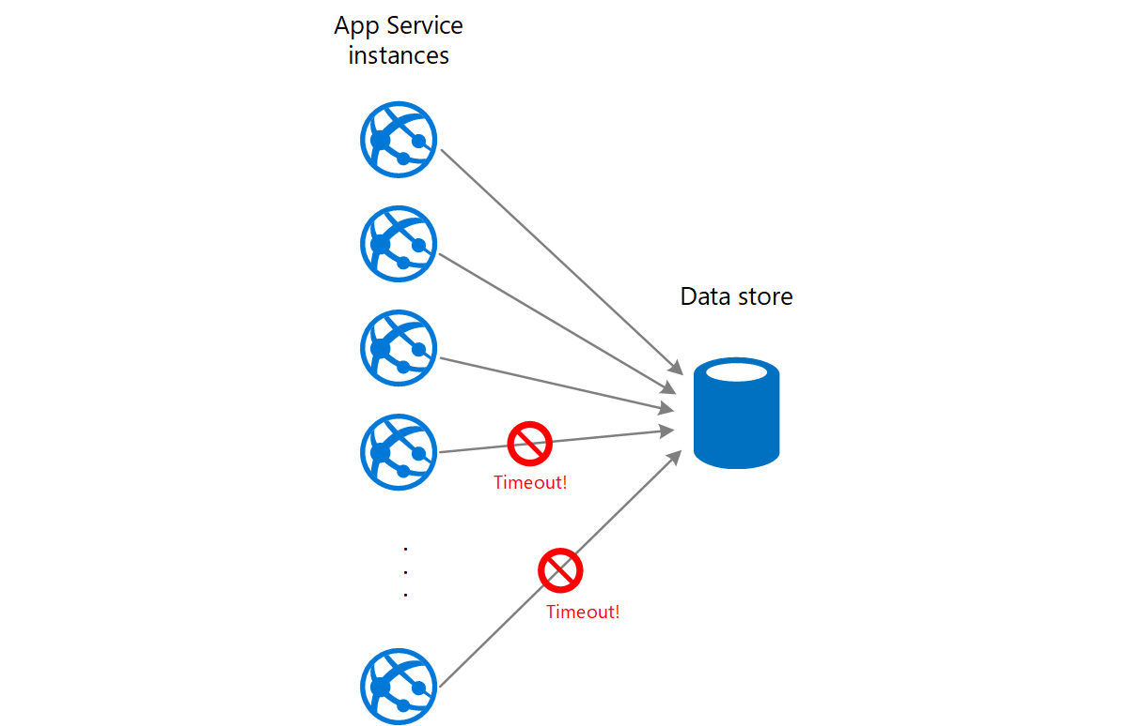
Example
A web app writes data to an external data store. If a large number of instances of the web app run concurrently, the data store might be unable to respond to requests quickly enough, causing requests to time out, be throttled, or otherwise fail. The following diagram shows a data store being overwhelmed by a large number of concurrent requests from instances of an application.

Slide 11
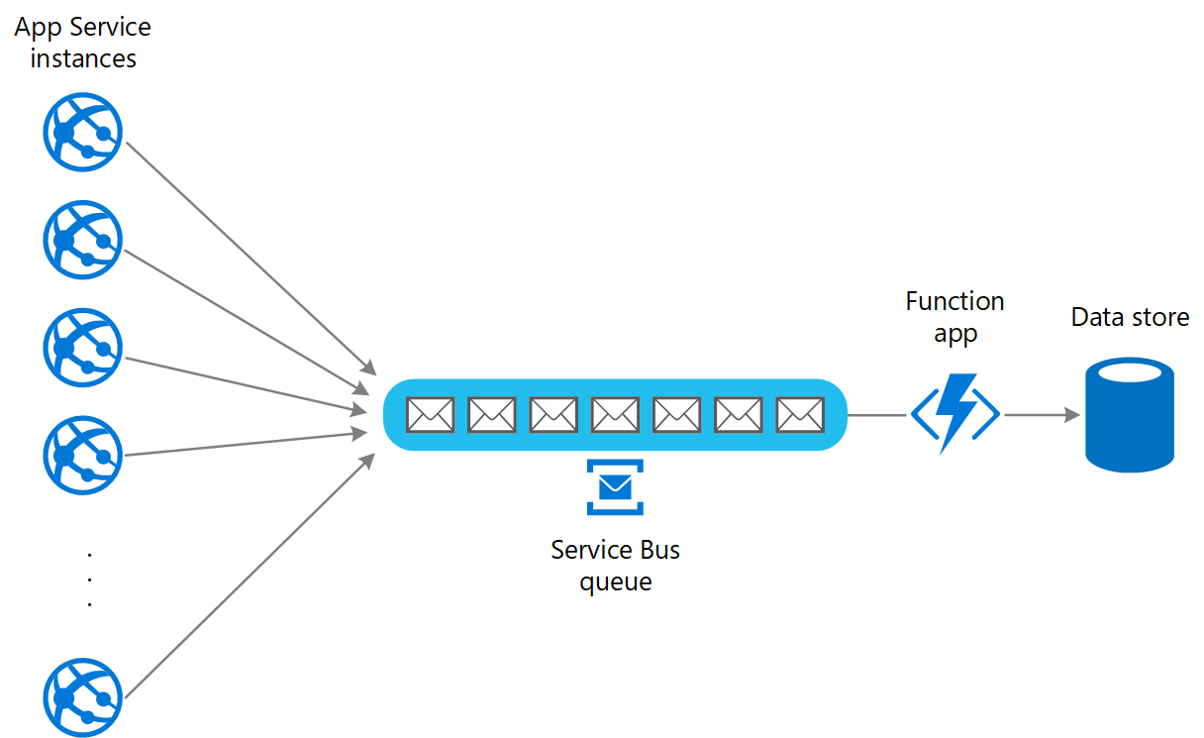
To resolve this, you can use a queue to level the load between the application instances and the data store. An Azure Functions app reads the messages from the queue and performs the read/write requests to the data store. The application logic in the function app can control the rate at which it passes requests to the data store, to prevent the store from being overwhelmed. (Otherwise the function app will just re-introduce the same problem at the back end.)

Slide 12
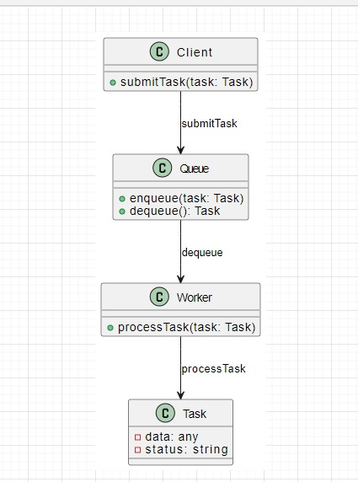
Structure Diagram

Slide 13
Explanation:
Client (Producer): Submits tasks to the system using the submitTask method.
Queue: Enqueues tasks from the client and dequeues tasks to be processed by workers. The enqueue method is used to add tasks to the queue, and the dequeue method is used to retrieve tasks.
Worker (Consumer): Retrieves tasks from the queue using the dequeue method and processes them using the processTask method.
Task: Represents a unit of work with associated data and status. Tasks are submitted by the client and processed by the worker.
Role of Each Component:
Client: Initiates tasks and submits them to the system.
Queue: Manages the flow of tasks, ensuring a balanced distribution and preventing overload on individual components.
Worker: Retrieves tasks from the queue and performs the actual processing.

